Slide 1

Department of CSIT
COURSE NAME
FOUNDATIONS OF CLOUD-NATIVE COMPUTING & DEVOPS
COURSE CODE –24CS2260F
Topic:
Git branching strategy
Session -

Slide 2
Overview of Version control systems
Version control is a system that records changes to a file or set of files over time so that specific versions can be recalled later. It is essential in managing project files in software development
By integrating Version control system into DevOps practices, teams can achieve higher efficiency, better collaboration, and more reliable software delivery.

Slide 3
Core functionalities
Code Repository Management: This involves storing and managing code in a central location, enabling multiple users to collaborate and operate on a project.
Branching and merging: Allows developers to create separate line of development, manage changes in isolation and integrate them back to main codebase without conflicts.
Change Tracking: Keeps a history of all the changes made to codebase, helping to understand what modifications are done by whom and when they were done

Slide 4
What is Git?
It is a Version Control System which
Keep careful track of changes in your ﬁles
Collaborate with others on your projects more easily
Test changes without losing the original versions
Revert back to older versions when/if needed
GitHub: web-based hosting service for git
Provides a "remote" location for storing your git workspaces
Useful if you lose/break your computer, etc.

Slide 5
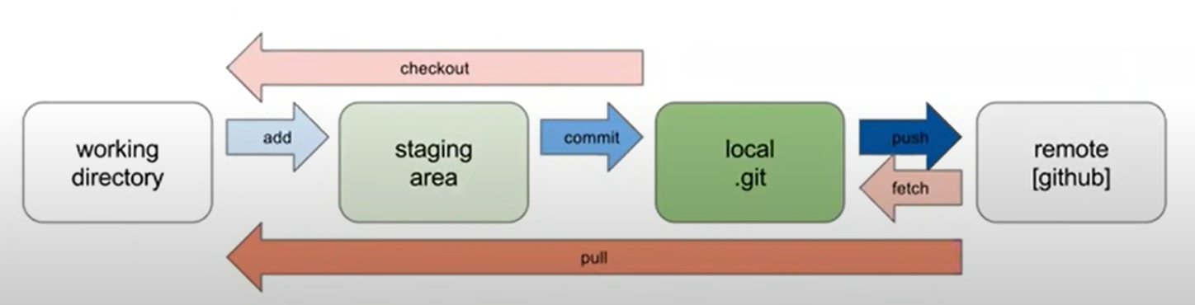
How it works
Initializing a Repository: When you initialize a folder with Git, it becomes a repository. Git logs all changes made to a hidden folder within that repository
Staging Changes: Git marks modified files as "staged." Staging prepares changes for a snapshot you want to keep
Committing Changes: Once staged changes are satisfactory, you commit them. Git maintains a complete record of each commit
Branching and Merging: Git allows you to create branches to work on different features or fixes independently. Once the work is complete, you can merge these branches back into the main branch

Slide 6
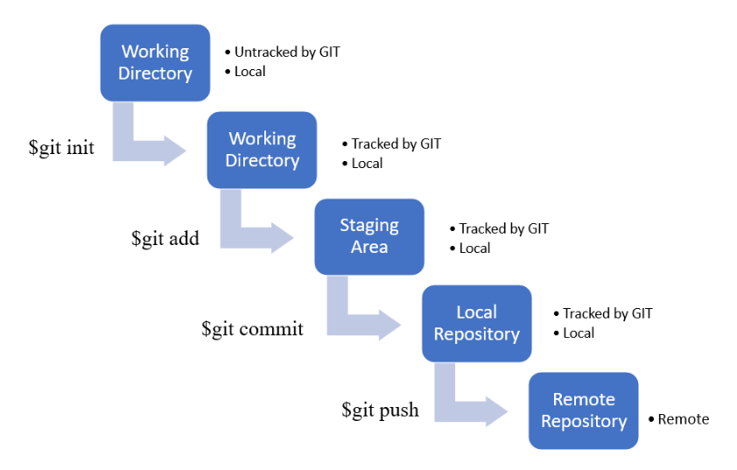

Slide 7
Git commands
git clone <url>
Downloads an existing repository from GitHub
Creates a synced, local copy
git add <filename>
If you create new files and/or folders, they are not tracked by Git unless you ask it to do so
git add- Signals to git that the speciﬁed ﬁle should be “tracked” for changes and Places modiﬁed ﬁle(s) in the “staging area”
git add . To add all the untracked files in the list in one go

Slide 8
git commit -m "message"
A commit is when you tell git that a change (or addition) you have made is ready to be included in the project.
Takes a "snapshot" of all files currently on the staging area and commits it to git's memory
The "snapshot" is captioned with the given message as a brief description for the commit

Slide 9
git status
Displays useful information about your repository (e.g., current branch, tracked/untracked files, differences between local and remote versions)
git push
Uploads local commits to the remote repository (i.e., from your computer to GitHub)
git pull
Downloads remote commits to the local repository (i.e., from GitHub to your computer)
git log
Displays history of commits made in the repository from newest to oldest

Slide 10
Branching
Each repository by default has a "master" branch where all your work lives
Sometimes useful to create separate branches in your repository (to test new features, separate work among collaborators, etc.)
By default, lists all of the branches in your repository, but has a few other variations:
git branch <branch>
○ Creates a new branch with the given name
git branch -d <branch>
○ Deletes the specified branch
git checkout <branch>
Switches from the current branch to the specified branch (must already exist)

Slide 11
git checkout -b <branch>
First creates a new branch with the given name, then switches to it
git merge <branch>
Merges the specified branch to the current branch
Merging is the process of combining changes from one branch into another. To merge changes, switch to the branch you want to merge into and use the `git merge`.

Slide 12
Git branching strategy
The following are different branching strategies:
Git Flow: Ideal for projects with fixed release cycles and multiple releases (e.g., enterprise apps).
GitHub Flow: Best for continuous delivery environments and small teams working on quick, iterative updates.
GitLab Flow: A good middle ground for teams that need flexibility, such as managing production and staging environments.
Trunk-Based Development: Ideal for teams practicing continuous integration and delivery with frequent releases.

Slide 13
1. Git Flow (For Structured Releases)
Git Flow is one of the most well-known branching strategies and is often used for projects with well-defined release cycles.
Branches:
Primary Branches:
master: Holds the production-ready code.
develop: Represents the latest development changes.
Supporting Branches:
feature/*: Feature branches for individual features or tasks.
release/*: Release branches for preparing a release.
hotfix/*: Branches to quickly fix production issues.

Slide 14
Workflow Example:
Developers create feature/xyz branches off of develop to work on a new feature.
When ready, a release branch is created from develop to finalize new features and perform testing.
If critical bugs arise in production, hotfix branches are created from master to address them

Slide 15
Git Workflow for Developing a Feature and Merging It into the Develop Branch
Procedure:
Switch to the Develop Branch
Command-
git checkout develop
2. Create a New Feature Branch
Command-
git checkout -b feature/new-feature
creates a new branch named feature/new-feature from the current branch (develop).
3. Complete the Feature Development
(Your development work would take place here, but no specific command is needed for this step. It's where you implement your feature.)

Slide 16
4. Switch Back to the Develop Branch
Command-
git checkout develop
After finishing the feature, you switch back to the develop branch to prepare for merging the changes.
5. Merge the Feature Branch into Develop
Command-
git merge feature/new-feature
This command merges the changes from the feature/new-feature branch into the develop branch

Slide 17
2. GitHub Flow (Recommended for Modern Teams)
GitHub Flow is a simpler workflow than Git Flow, designed for continuous deployment (CD) environments where features are deployed as soon as they are merged.
Branches:
main: Production-ready code.
feature/*: Temporary branches for individual features or fixes.
Workflow Example:
Developers create a feature/* branch off main to work on a feature.
Once completed, they create a pull request (PR) to merge the feature branch into main.
CI/CD runs tests and if everything is fine, the PR is merged, and the feature is deployed immediately

Slide 18
Git workflow for developing a feature in a separate branch and merging it into the main branch using a pull request on GitHub
Procedure:
Switch to the Main Branch
Command-
git checkout main
2. Create and Switch to a New Feature Branch
Command-
git checkout -b feature/awesome-feature
3. Push the Feature Branch to the Remote Repository
Command-
git push origin feature/awesome-feature

Slide 19
4. Create a Pull Request (PR) on GitHub
This is not a Git command, but a GitHub action:
After pushing the branch, go to GitHub (or your Git hosting platform) and create a Pull Request (PR) to merge your changes into main. This allows team members to review the changes before merging.
5. Merge the Feature Branch into Main
On GitHub or your Git platform interface:
Once the PR is reviewed and approved, merge the feature branch (feature/awesome-feature) into main, incorporating the changes into the stable production code.

Slide 20
3. Trunk-Based Development (TBD) :
In Trunk-Based Development (TBD), developers work with a single main branch (called "trunk" or main) and frequently merge changes into it. This approach emphasizes continuous integration, and all work is integrated frequently.
Branches:
main: Always holds the latest code.
feature/* (short-lived branches): Temporary feature branches used for a few days.
Workflow Example:
Developers work in short-lived feature/* branches or directly on main.
Continuous integration tools run tests on each commit.
Developers integrate their changes into main at least once a day.

Slide 21
Pull Request (PR) checks

Slide 22
PR checks ensure your code is high quality, bug-free, secure, and meets the project's standards.
These checks are mostly automated and Common PR checks are as below:
Code review (manual).
Automated tests (CI checks).
Code linting (style and formatting checks).
Build checks (ensuring the code can be compiled).
Security scanning (checking for vulnerabilities).
These checks help teams maintain the quality and security of the codebase and prevent breaking the main branch.

Slide 23
1. Code Review (Manual Check)
What it is: A team member (or multiple people) reviews the code to ensure it follows best practices, is well-structured, and doesn't introduce bugs or security issues.
How it works: After submitting a PR, reviewers go through the changes, leave comments, and approve or suggest changes.
Example:
You create a feature that adds a login form.
Your team member reviews the code, checks if the logic is correct, asks for comments on some functions, and suggests renaming a variable for clarity.

Slide 24
2. Continuous Integration (CI) Tests
What it is: CI tools like GitHub Actions, Jenkins, or Travis CI automatically run tests to ensure your code works as expected and doesn't break existing functionality. These tests can include unit tests, integration tests, and linting checks.
How it works: When you create a PR, the CI tool runs the automated tests defined for the repository. If any test fails, the PR will be marked with a failed check, and you must fix the issue before merging.
Example:
You add a new function to validate email addresses.
The CI runs unit tests to ensure that the email validation function works as expected (e.g., handling valid and invalid email formats).
If the tests pass, the PR shows a "green checkmark." If they fail, the PR shows a "red X" and you’ll need to fix the test failures.

Slide 25
3. Code Linting (Static Analysis)
What it is: Linting tools like ESLint, Prettier, or Pylint automatically analyze your code for style issues and potential errors, such as missing semicolons, improper indentation, or unused variables.
How it works: Linting tools are often configured to run automatically during a PR. If your code doesn’t meet the style rules defined for the project, the PR will show a linting error.
Example:
You submit a PR where you forgot to add a semicolon at the end of a line of JavaScript code.
The linting check will highlight this as a style issue, and you’ll need to fix it before merging.

Slide 26
4. Build Status (Build Check)
What it is: This check ensures that the build process is successful after your changes are merged. A failing build means the code cannot be compiled or packaged into a usable product.
How it works: The CI pipeline typically includes a build step that compiles the project. If the build fails (for example, due to missing dependencies or broken code), the PR will not be merged.
Example:
You make a change to the package.json file in a Node.js project, but you accidentally remove a required dependency.
The build step will fail because the necessary dependency isn’t installed, and the PR won’t merge until you fix the issue.

Slide 27
5. Security Scanning
What it is: Some repositories use automated tools (like Dependabot, Snyk, or GitHub’s secret scanning) to scan for security vulnerabilities in the code.
How it works: The system checks for things like insecure dependencies, exposed API keys, or known security vulnerabilities in your code. If it detects any issues, it flags them as a security risk.
Example:
You accidentally add a private API key to your codebase in the PR.
The security check flags the PR because it detects a secret key, and you'll need to remove it or replace it with a secure method (like environment variables).

Slide 28
6. Approval and Merging Permissions
What it is: Some repositories require approvals from one or more team members before merging a PR.
How it works: Even if all the checks pass, the PR may need to be approved by a designated person (e.g., the project owner or lead developer). This ensures that at least one person reviews the code before it’s merged.
Example:
You create a feature, and once all checks pass (tests, linting, etc.), a reviewer (who is set as an approver) approves the PR, and then you can merge the PR into the main branch.

Slide 29
7. Dependency Check (Optional)
What it is: Some repositories check for dependency updates to ensure that there are no outdated or insecure dependencies in the code.
How it works: This check makes sure that the PR doesn’t introduce any outdated libraries that could cause compatibility issues or security vulnerabilities.
Example:
Your PR includes an update to a library (e.g., upgrading React to a newer version).
The dependency check ensures that the update doesn’t conflict with other parts of the project, and the CI tools verify that the system still works as expected.

Slide 30
How PR Checks are Shown on GitHub:
When you create or update a PR, you'll see the status of each check in the "Checks" tab on GitHub.
For example:
"CI Tests Passed": Shows a green checkmark if all automated tests passed.
"Build Failed": A red X indicates that the build process failed.
"Pending Review": A label indicating that the PR still needs manual review and approval.
"Security Alert": If there is a detected security vulnerability.

Slide 31

THANK YOU
Team –Foundations Of Cloud-native Computing & Devops

